Slide 1
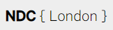



Getting Started with GitHub Actions
Feel free to tweet along with the show: @mickey_gousset
Track 5
Mickey Gousset
DevOps Architect – GitHub
github.com/mickeygousset

Slide 2



What is Tupelo, MS world-famous for?

Slide 3









































GitHub is the largest developer platform on Earth
50M+
100M+
1,000s
1B+
3M+
50%
Developers
Private and public
repositories
Top open source
communities
Contributions
per year
Organizations
Fortune 500
companies
The most innovative companies
The top open source projects
Leading global enterprises
Largest DevOps ecosystem

Slide 4


Our Vision
We empower your teams to securely & rapidly innovate on customer experiences that drive business results
Enterprise core
Mobile app
Happier customers
Happier developers
Faster feedback
Build faster
CI/CD & hosting
OSS & API services
Intelligent workspaces
Insights & talent platform
Expert support
Customers
Faster feedback
Products
Better experiences
Ship more securely
Incidence mgmt. & debug
Testing & security
OSS governance

Slide 5
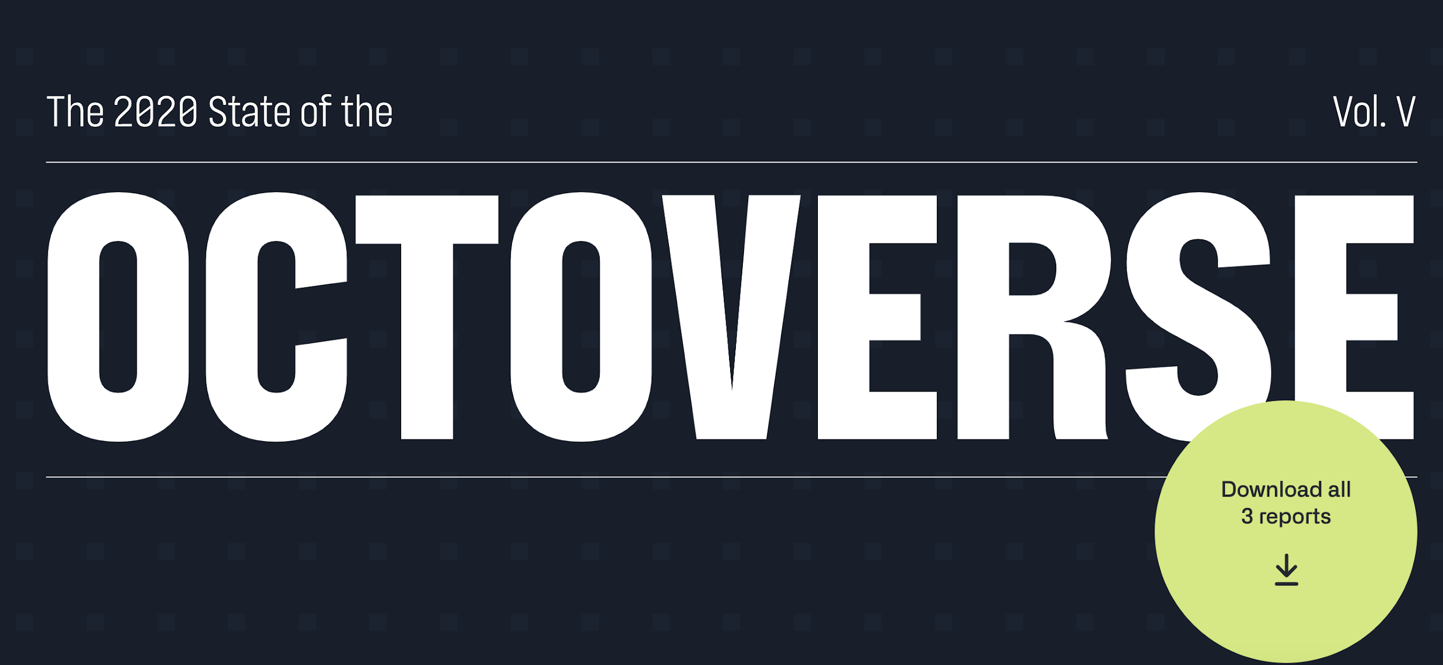
octoverse.github.com

Slide 6
What is DevOps
Develop
DevOps is the union of people, process, and products to enable continuous delivery of value to your end users.
DevOps
Operate
Deliver

Slide 7
What are GitHub Actions?
#1
CI on GitHub
6,800+
Actions in GitHub Marketplace
Custom workflows triggered on any GitHub event
World class CI/CD primitives
Matrix builds
Live, streaming logs
Built in secret store
Familiar YAML syntax
Linux, macOS, and Windows hosted runners
Self hosted runners
GitHub Enterprise Server support
Any platform, any language, any cloud
Events
Trigger
Workflows
Use
Actions

Slide 8
Why GitHub Actions is(are?) Important To You – Some Stats
Open Source projects using GitHub Actions merged 34% more pull requests
Open Source projects using GitHub Actions decreased time to merge by 18%

Slide 9
Terminology

Slide 10
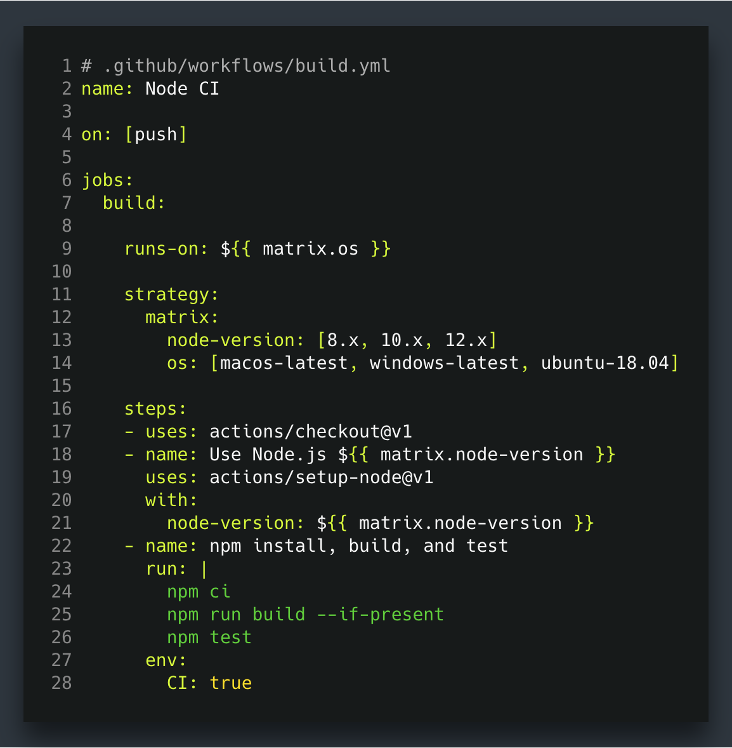
Workflows
Workflows let you codify useful processes to your liking. They belong in YAML files in a special directory in your repository, .github/workflows.
Examples
Organizational: Welcoming new contributors
Legal: Ensuring license uniformity
Application: Testing across multiple operating systems
Events
Trigger
Workflows
Use
Actions

Slide 11
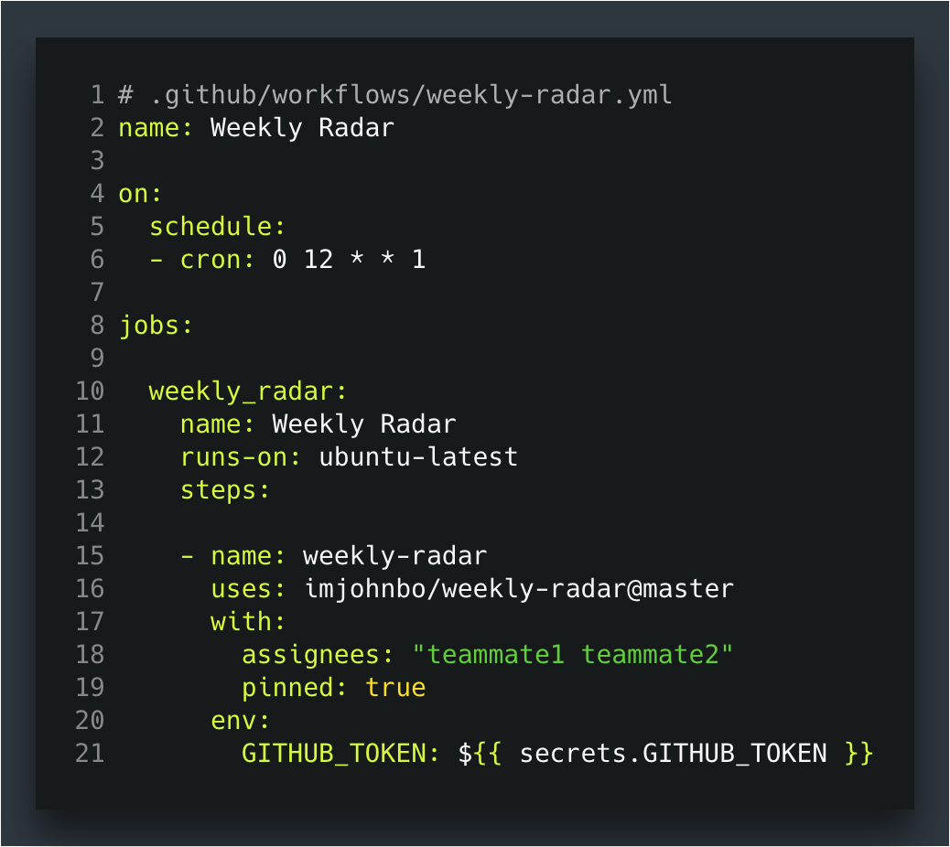
Events
Workflows are triggered on events:
push, pull_request, public, etc.
schedule
workflow_dispatch (manual trigger)
Events
Trigger
Workflows
Use
Actions

Slide 12
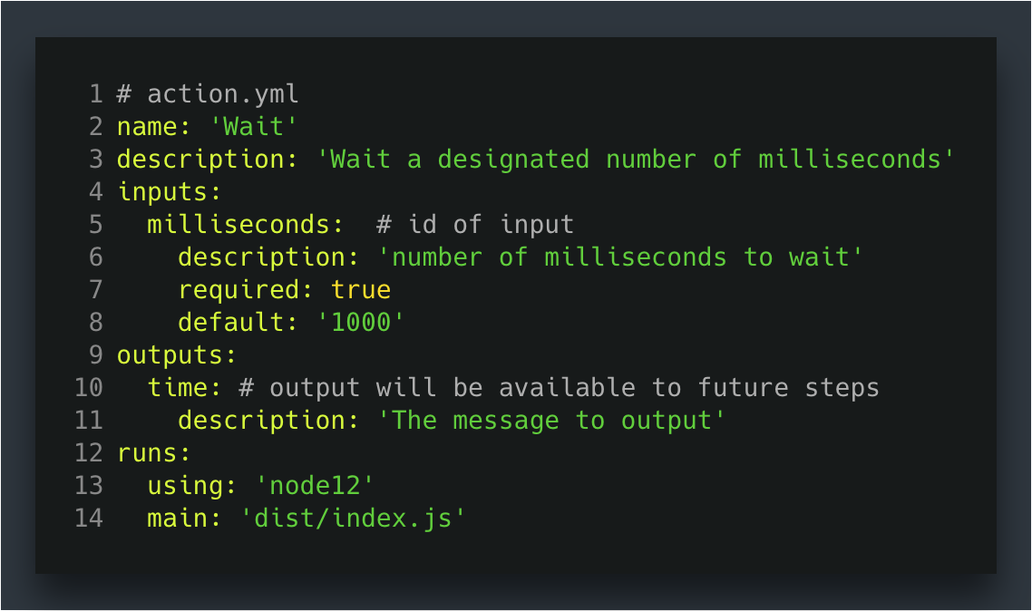
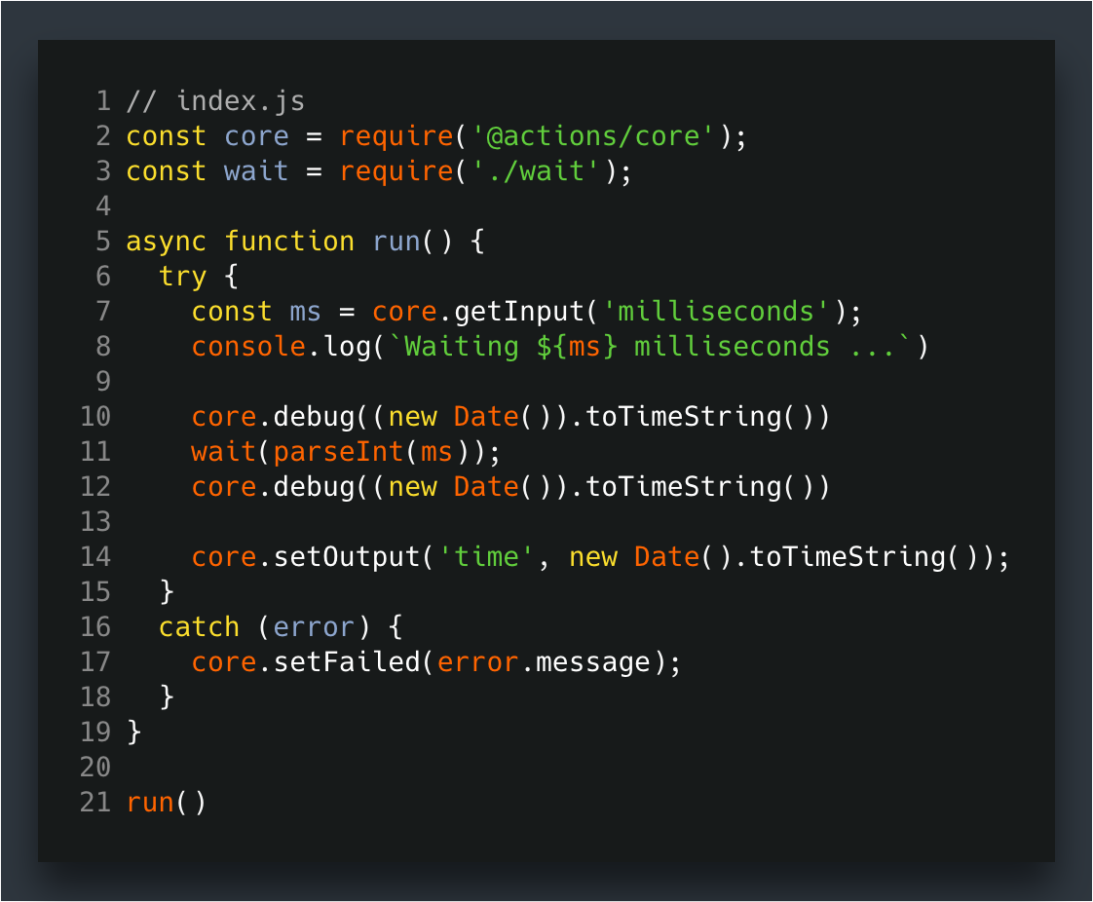
Actions
Actions are reusable units of code made available to your workflows. GitHub runs them in a Node.js runtime or in Docker containers and are referenced from workflows as uses: owner/repo@ref.
Examples
stale
Azure WebApp
Lots more on GitHub Marketplace
Events
Trigger
Workflows
Use
Actions

Slide 13
Secrets
Secrets are encrypted variables you can create in an organization, repository, or repository environment.
Available to use in GitHub Actions workflows
Events
Trigger
Workflows
Use
Actions

Slide 14
Environments
Currently in Beta
Targeted by jobs in a workflow
Specify required reviewers, wait timers, and environment level secrets
Events
Trigger
Workflows
Use
Actions

Slide 15
Hosted Runners
VM hosted by GitHub with the Actions Runner app installed
Linux, Windows, and macOS
Machine maintenance and upgrades are handled by GitHub
Open source
Preinstalled software
Free for public repos

Slide 16
What about self-hosted runners?
Open Source: https://github.com/actions/runner
Create your own custom runner w/ whatever customizations you need (more hardware, OS, on-prem, in cloud, etc)
Free to use with GitHub Actions, but you're responsible for cost of maintaining your runner machine(s)
GitHub recommends AGAINST using self-hosted runners for public repos

Slide 17
Build Your Own Actions
 | JavaScript action | Container action
Virtual environment | Linux, MacOS, Windows | Linux
Language | Anything that compiles to JavaScript | Any
Speed | ++ | +
User experience | ++ | +
TLDR; Write in the language and environment that makes sense for you.
JavaScript actions are faster, runtime is more versatile, and offer a better user experience.
Events
Trigger
Workflows
Use
Actions

Slide 18
That’s enough to get us started…
Demos
Hello, World (of course)
Hello, World (Matrix-style)
Everyone gets a job
Context can be important

Slide 19
For My Next Set of Demos
Approvals/Environments
PRs and Pushes
3 Environments (DEV/QA/PROD)
DEV – manual approval
QA – nothing
PROD – 1 minute wait
Main Branch w/ feature branches
On PR, run checks using GitHub Actions
On Push to Main branch, run GitHub Actions
Require PR GitHub Action workflow to pass in order to merge

Slide 20
Ok, let’s do this for reals…
.NET Core MVC App
On PR, will execute build/test to verify clean code
On Push to Main:
Build app
Deploy to DEV and QA at the same time
Manual approval to PROD

Slide 21
Now let’s have a little fun….
https://github.com/mickeygousset/ndclondon2021
Wait till I tell you……
…. Then star the repo…….

Slide 22
My Actions Pro-Tips

Slide 23
# Trigger workflows externally
on: repository_dispatch
# POST /repos/:owner/:repo/dispatches
{
"event_type": "custom-name",
"client_payload": {
"custom_message": “Hello world!”
}
}

Slide 24
# Scheduled workflows with CRON syntax
on:
schedule:
# * is a special character in YAML # so you have to quote this string
- cron: ’*/15 * * * *’

Slide 25
# Resolve dependencies across jobs
jobs:
Job1:
# ...
Job2:
needs: Job1
# ...
Job3:
needs: [Job1, Job2]
# ...

Slide 26
# Run a job based on previous step exit status
jobs:
MyJob:
Steps:
# ...
- name: Trigger alert
if: failure()
# if: success()
# if: canceled()
# if: always()

Slide 27
# Use the built-in Secrets store
jobs:
MyJob:
steps:
# ...
- uses: azure/login@v1
with:
creds:
${{ secrets.AZURE_CREDENTIALS }}

Slide 28
Resources
https://octoverse.github.com/
https://github.com/sdras/awesome-actions
https://docs.github.com/en/actions/reference
https://github.com/mobile/
https://elvispresleybirthplace.com/

Slide 29

Q&A
Mickey Gousset
https://github.com/mickeygousset
https://mickeygousset.com
Twitter: @mickey_gousset
Email: mickeygousset@github.com

